Slide 1
CANNY EDGE DETECTION COMPUTER VISION AD23402
BY
MENAKA.J
2023510025

Slide 2
INTRODUCTION:
Edge detection is a fundamental technique in image processing and computer vision.
It aims to identify points in a digital image where brightness changes sharply, often corresponding to object boundaries.
Canny Edge Detection, developed by John F. Canny in 1986, is one of the most widely used edge detection algorithms due to its optimal accuracy and reliability.
It is a set of several procedures to find almost all the edges that could be potentially present in the image in a very precise manner.
It includes several stages, starting from smoothing using a Gaussian filter, then computing the gradients, thinning the responses via a method called non-maximum suppression, and lastly hysteresis thresholding to connect the edges properly and eliminate the weak ones.

Slide 3
NEED FOR CANNY:
We can detect edge in the image using many edge detection technique
Robert’s edge detection
Sobel edge detection
Prewitt edge detection
These traditional methods often suffer from issues such as noise sensitivity, poor localization, and multiple responses to a single edge.
Although we have many techniques to find edge in an image, Canny gave better edges by ignoring week edges and consider only strong edges and edges connected to it.
Canny also has an advantage since it use the concept of “Thresholding” in image.

Slide 4
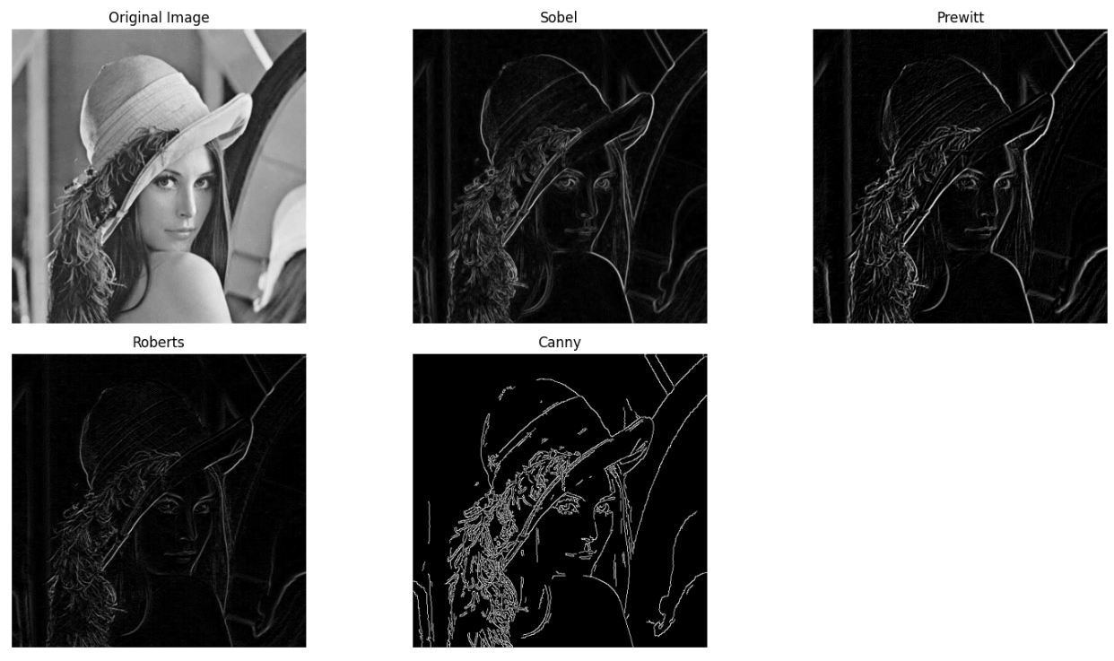
CANNY OVER OTHER METHODS:
Good detection (low error rate)
Good localization (accurate position)
Minimal response (one response per edge)

Slide 5
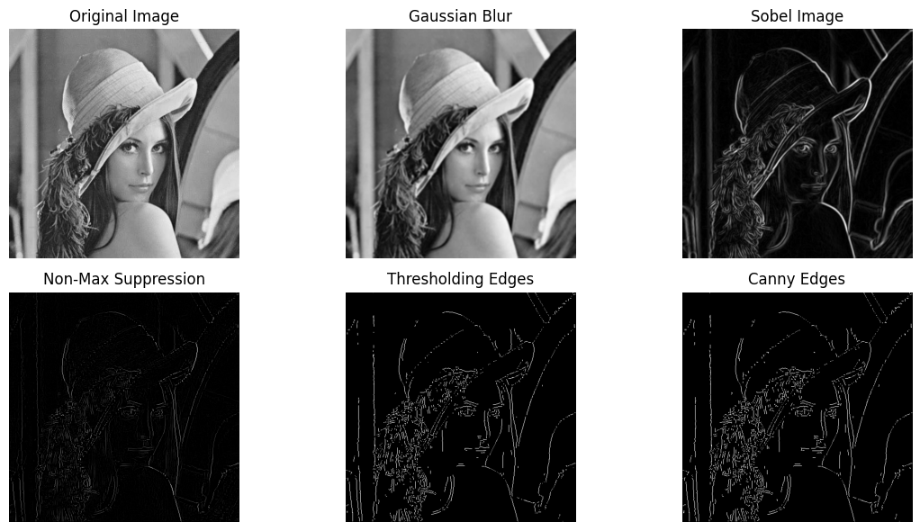
STEPS IN CANNY EDGE DETECTION:
Gaussian Smoothing – reduces noise.
Gradient Magnitude[Sobel Filter] – detects intensity changes.
Non-Maximum Suppression – thins edges.
Double Thresholding – classifies strong and weak edges.
Final Canny Edges – tracks edges by hysteresis to finalize.
Before applying gaussian blur , convert the image to Grayscale image.

Slide 6
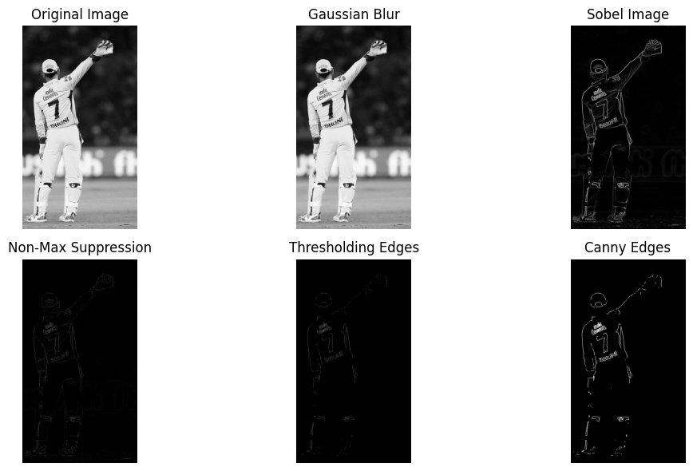
FLOW OF CANNY EDGE STEPS:
SMOOTHING
GAUSSIAN
GRADIENT MAGNITUDE & DIRECTION
[SOBEL]
NON-MAXIMAL SUPPRESSION
DOUBLE THRESHOLDING
FINAL EDGES

Slide 7

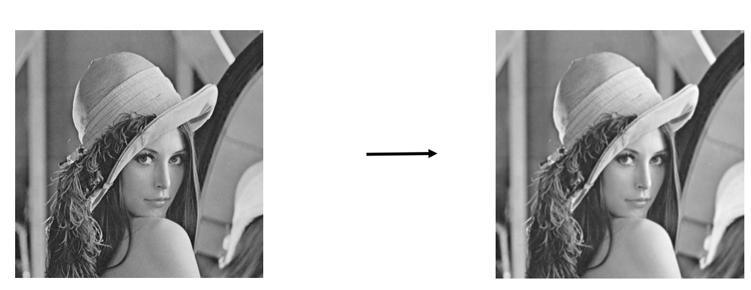
STEP 1 – GAUSSIAN SMOOTHING:
📌 Purpose: To reduce noise and minor variations in the image to prevent false edge detection.
❓ How: Convolve the image with a Gaussian filter.
📐 Formula:
Where:
G( x, y ) is the Gaussian kernel.
σ is the standard deviation (controls smoothing).
💡 Key Point:
Removes high-frequency noise.
Larger σ → more smoothing, but can blur edges.
Gaussian blur

Slide 8
STEP 2 – GRADIENT MAGNITUDE & DIRECTION:
📌 Purpose: To find regions with high intensity changes in both X and Y direction (edges).
🔍 What Are Gradients?
A gradient measures the rate of change in pixel intensity.
In edge detection, a large gradient means a sudden change — indicating a potential edge.
🧠 Why Gradients?
Edges occur where there is a sharp change in brightness, which corresponds to high gradients in the image.
📈 Visual Interpretation:
Gx detects vertical edges (intensity changes along x-axis).
Gy detects horizontal edges (intensity changes along y-axis).
The combination of Gx and Gy gives us the complete edge structure.

Slide 9
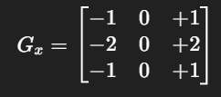
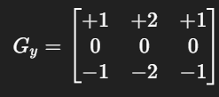


STEP 2 – GRADIENT MAGNITUDE & DIRECTION:
⚙️ How It’s Done:
Apply derivative filters (Sobel operators) to detect intensity change in both horizontal (x) and vertical (y) directions.
2.Compute horizontal and vertical gradients:
Where
‘I’ is the image
* Is the convolution
Calculate Gradient Magnitude:
​​ This gives the strength of the edge at each pixel.

Slide 10

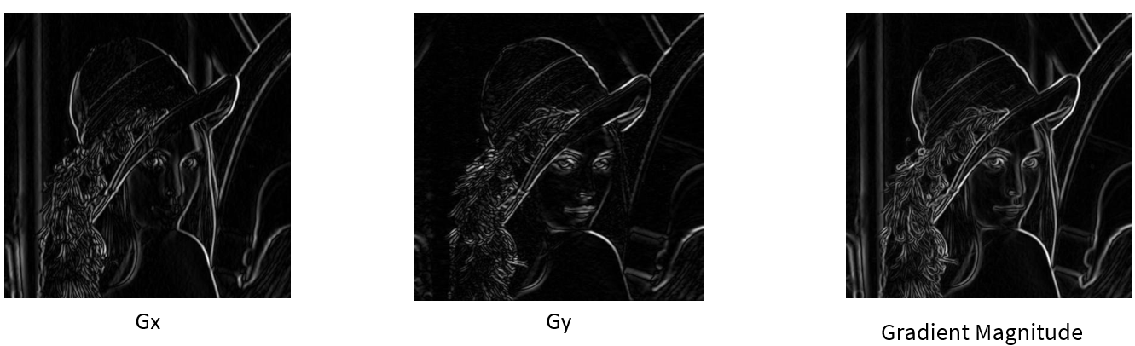
STEP 2 – GRADIENT MAGNITUDE & DIRECTION:
Calculate Gradient Direction:
This gives the orientation of the edge (used in Step 3 for Non-Maximum Suppression).
💡 Key Point:
Strong edges → high gradient magnitude.
Direction used in the next step.

Slide 11
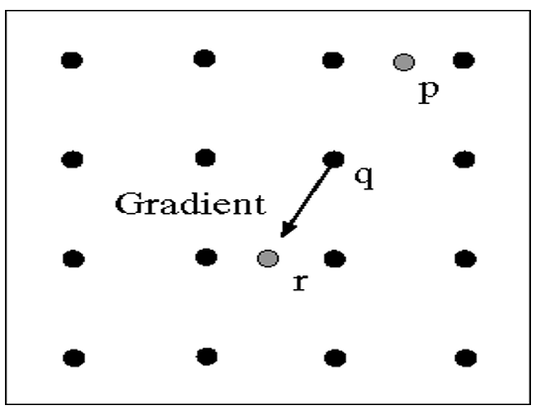
STEP 3 – NON-MAXIMAL SUPPRESSION:
📌 Purpose:
To thin out the wide edges detected in the gradient step, keeping only the pixels that are local maxima in the gradient direction.
❓ How:
A pixel is retained as an edge only if it has the highest intensity compared to its two neighboring pixels along the gradient direction.
If the center pixel 𝑞 is greater than both neighbors 𝑝 and 𝑟, it is kept.
Otherwise, it is suppressed (set to zero or black).

Slide 12
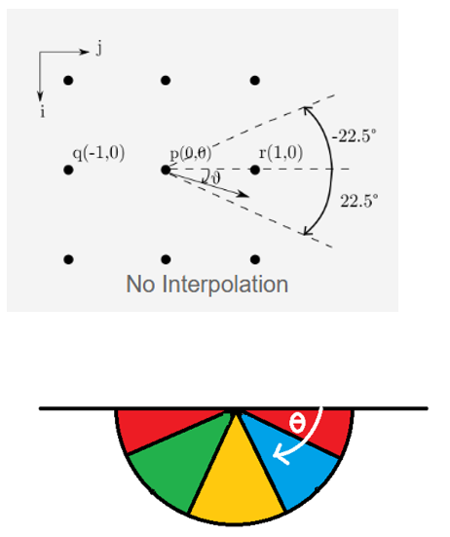
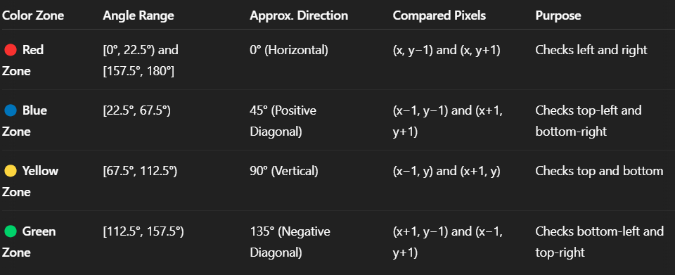
STEP 3 – NON-MAXIMAL SUPPRESSION:
📐 Gradient Directions:
Since the gradient direction is a continuous angle (0°–180°), it's approximated to four main directions, based on angle intervals:

Slide 13
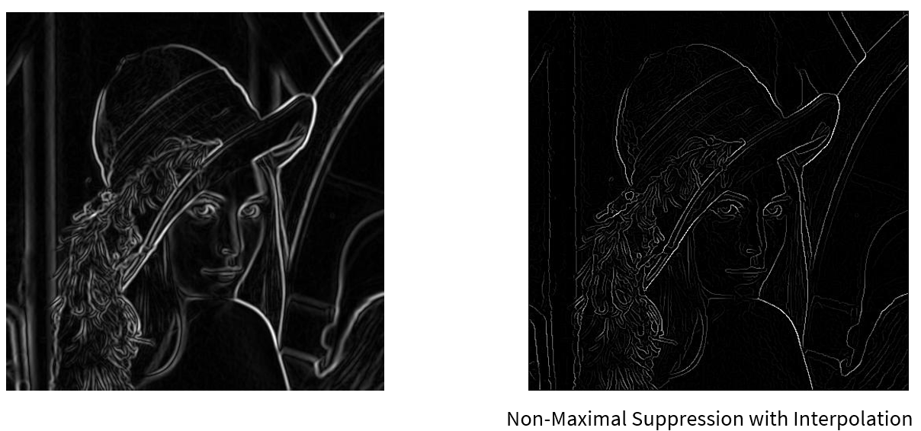
STEP 3 – NON-MAXIMAL SUPPRESSION:
🧾 Algorithm Steps:
For each pixel ‘q’ with gradient magnitude and direction:
Identify the direction group (0°, 45°, 90°, or 135°) from the gradient angle.
Compare ‘q’ with neighboring pixels ‘p’ and ‘r’ in that direction.
If q>p and q>r → keep pixel (possible edge).
Else → suppress pixel (set to 0 or black).

Slide 14
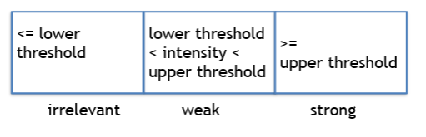
STEP 4 – DOUBLE THRESHOLDING:
📌 Purpose:
To classify edge pixels into strong, weak, or non-relevant edges, based on gradient magnitude, so that we can later determine which ones are true edges.
❓ How:
Use two thresholds:
High threshold (T _ high): Pixels > T _ high → Strong edges.
Low threshold (T _ low): Pixels between T _ low and T _ high → Weak edges.
Below T _ low → Non-edges.
💡 Key Point:
Helps distinguish actual edges from noise.
Weak edges may be real if connected to strong edges.

Slide 15
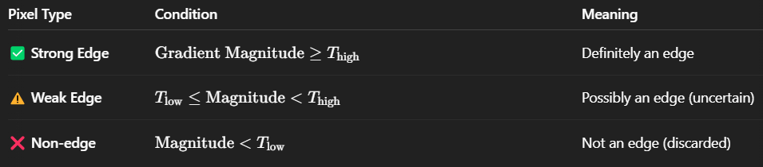
STEP 4 – DOUBLE THRESHOLDING:
📐 How It Works:
Double Thresholding applies two thresholds to the gradient magnitude image:
💡 Points to remember:
High threshold ensures only clear, prominent edges are marked as strong.
Low threshold helps include weak edges that might be part of a real edge.
This step alone does not confirm whether weak edges are valid — that's handled in the next step (Edge Tracking by Hysteresis).

Slide 16
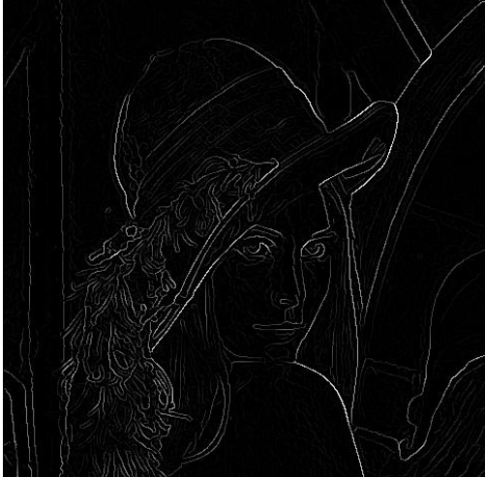
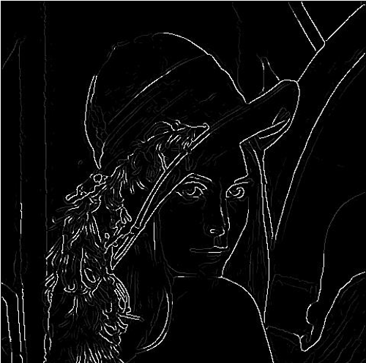
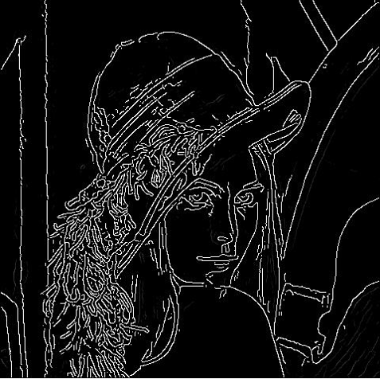
STEP 4 – DOUBLE THRESHOLDING:
Non-maximal suppression with interpolation
Edges detected with T-low and T-high
Edges detected with another T-low and T-high

Slide 17
STEP 5 – FINAL EDGES BY HYSTERIS:
📌 Purpose:
To determine which weak edges from the previous step are part of real edges, by checking if they are connected to strong edges.
🔗 Key Principle:
Strong edges are always retained (they are definitely edges).
Weak edges are kept only if they are connected to strong edges through neighborhoods.
Unconnected weak edges are discarded (converted to black).
💡 Need:
Hysteresis here means that “weak edges follow strong edges” — they are only preserved if they are linked to strong ones.
This avoids breaking apart edges while removing stray noise pixels.

Slide 18
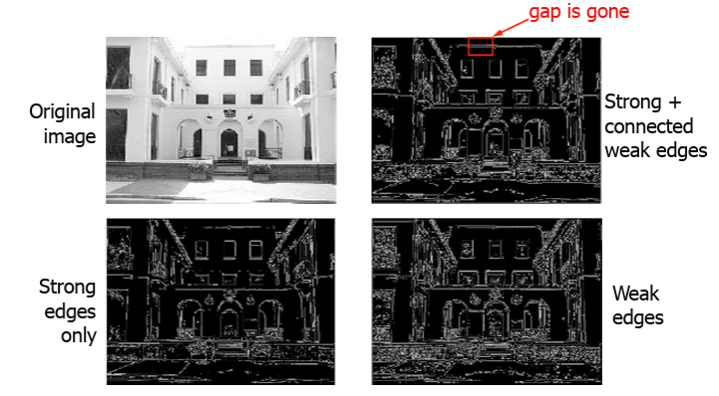
STEP 5 – FINAL EDGES BY HYSTERIS:
✅ Step-by-Step Breakdown:
Traverse the entire image pixel-by-pixel
For each pixel that is labeled as a weak edge:
Check its neighbors (surrounding pixels).
If any neighbor is a strong edge, upgrade the current weak pixel to a strong edge.
If no neighbors are strong:
Set the current weak pixel to zero (discard it — not an edge).
Continue this process for all pixels.
The result is a clean binary image where:
Strong edges are white (255),
All others (weak & non-edges) are black (0).

Slide 19
ADVANTAGES:
✅ Advantages of Canny Edge Detection:
High Accuracy: Detects a wide range of edges with minimal error.
Noise Reduction: Uses Gaussian filter to smooth out noise before detecting edges.
Edge Localization: Finds edge positions with high precision.
Thin Edges: Non-Maximum Suppression ensures edges are one-pixel wide.
Selective Edge Detection: Double thresholding helps distinguish between strong and weak edges.
Connectivity: Hysteresis ensures only meaningful edges (connected to strong edges) are retained.
Low False Detections: Reduces chances of detecting irrelevant or noise-induced edges.

Slide 20
DISADVANTAGES:
❌ Disadvantages of Canny Edge Detection:
Computationally Intensive: Involves multiple complex steps, making it slower than simpler methods.
Parameter Sensitive: Requires careful tuning of low and high threshold values for optimal results.
May Miss Fine Edges: Over-smoothing or poor thresholding may lead to loss of weak but important edges.
No Color Edge Detection: Operates on grayscale images; cannot detect color-specific edges.
Fixed Kernel: Uses predefined Sobel kernels; not adaptive to content-specific edge patterns.

Slide 21
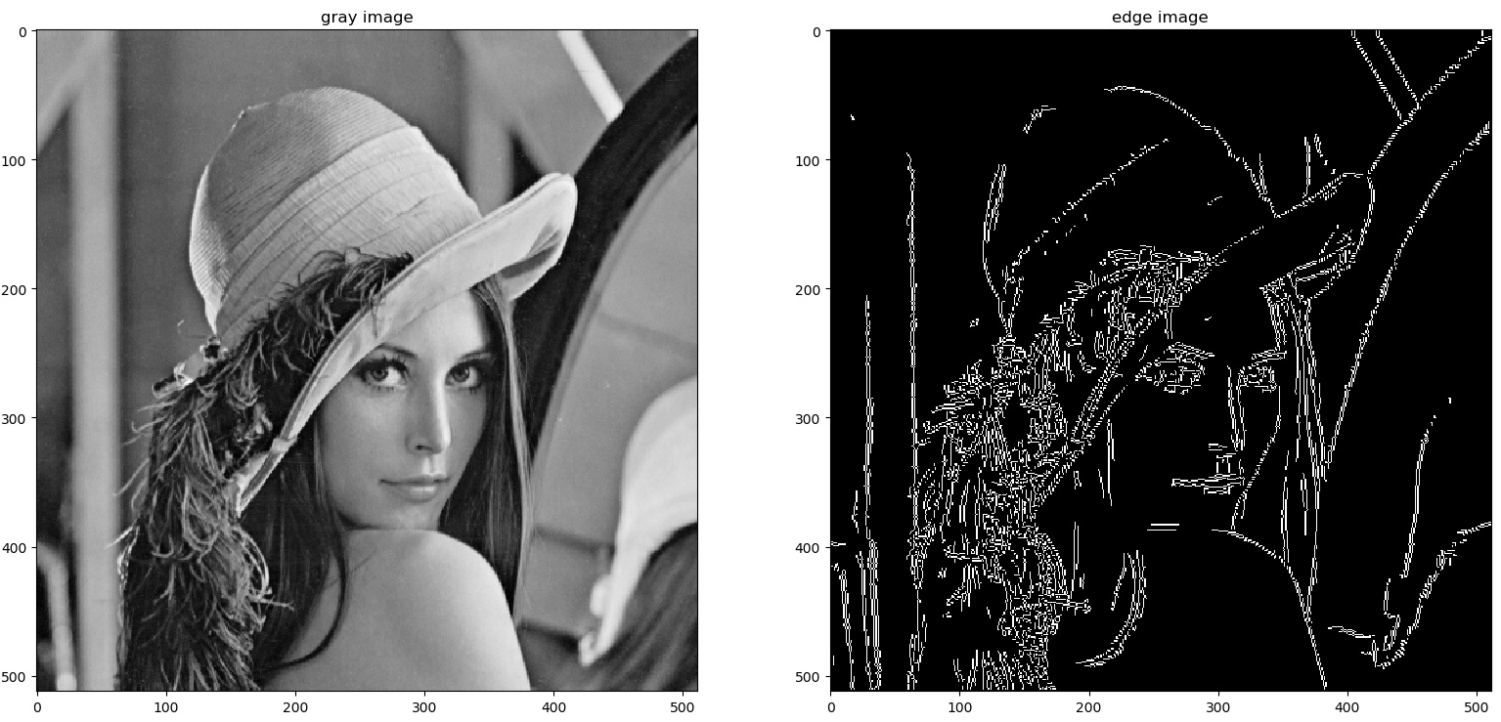
PYTHON IMPLEMENTATION:
import cv2
import matplotlib.pyplot as plt
# Load the image in grayscale
image = cv2.imread('your_image.jpg', cv2.IMREAD_GRAYSCALE)
# Apply Gaussian Blur to reduce noise (Step 1)
blurred = cv2.GaussianBlur(image, (5, 5), 1.4)
# Apply Canny edge detection (Steps 2–5 are internal)
edges = cv2.Canny(blurred, threshold1=50, threshold2=150)
# Display original and edge-detected images
plt.figure(figsize=(10,5))
plt.subplot(1, 2, 1)
plt.imshow(image, cmap='gray')
plt.title('Original Grayscale Image')
plt.axis('off')
plt.subplot(1, 2, 2)
plt.imshow(edges, cmap='gray')
plt.title('Canny Edge Detection')
plt.axis('off')
plt.tight_layout()
plt.show()
SAMPLE OUTPUT:

Slide 22
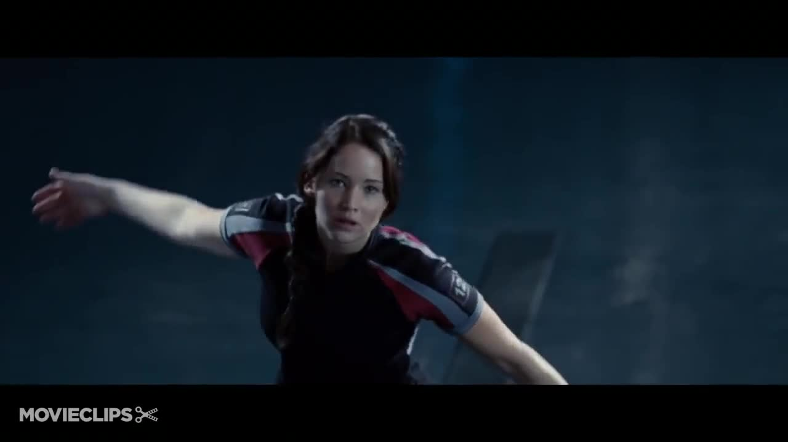
THANK YOU!!!!!!!!

